Slide 1

Bank Loan of Customers
Group : 6
Members
Akilesh V
Sonam Santosh Phadtare
Ashwini
Riddhish Ramesh Supanekar

Slide 2
Objective
This project involved analyzing two datasets containing customer loan information with 39,000 rows each. The objective was to assess the bank's loan growth over a certain period. To accomplish this, various tools were utilized:
Data Cleaning and Analysis: Excel and MySQL were used to clean the data, perform analysis, and remove duplicates from the datasets.
Dashboard Creation: Tableau and PowerBI were employed to create interactive dashboards. These tools facilitated calculations, merging of datasets, and visualization of key metrics related to loan growth.
Overall, the project aimed to provide insights into the bank's loan portfolio and track its growth over time through the creation of visually appealing and informative dashboards.

Slide 3
Contents
KPI-1 : Year wise loan amount Stats
KPI-2 : Grade and sub grade wise revol_bal
KPI-3 : Total Payment for Verified Status Vs Total Payment for Non Verified Status
KPI-4 : State wise and last_credit_pull_d wise loan status
KPI-5 : Home ownership Vs last payment date stats

Slide 4
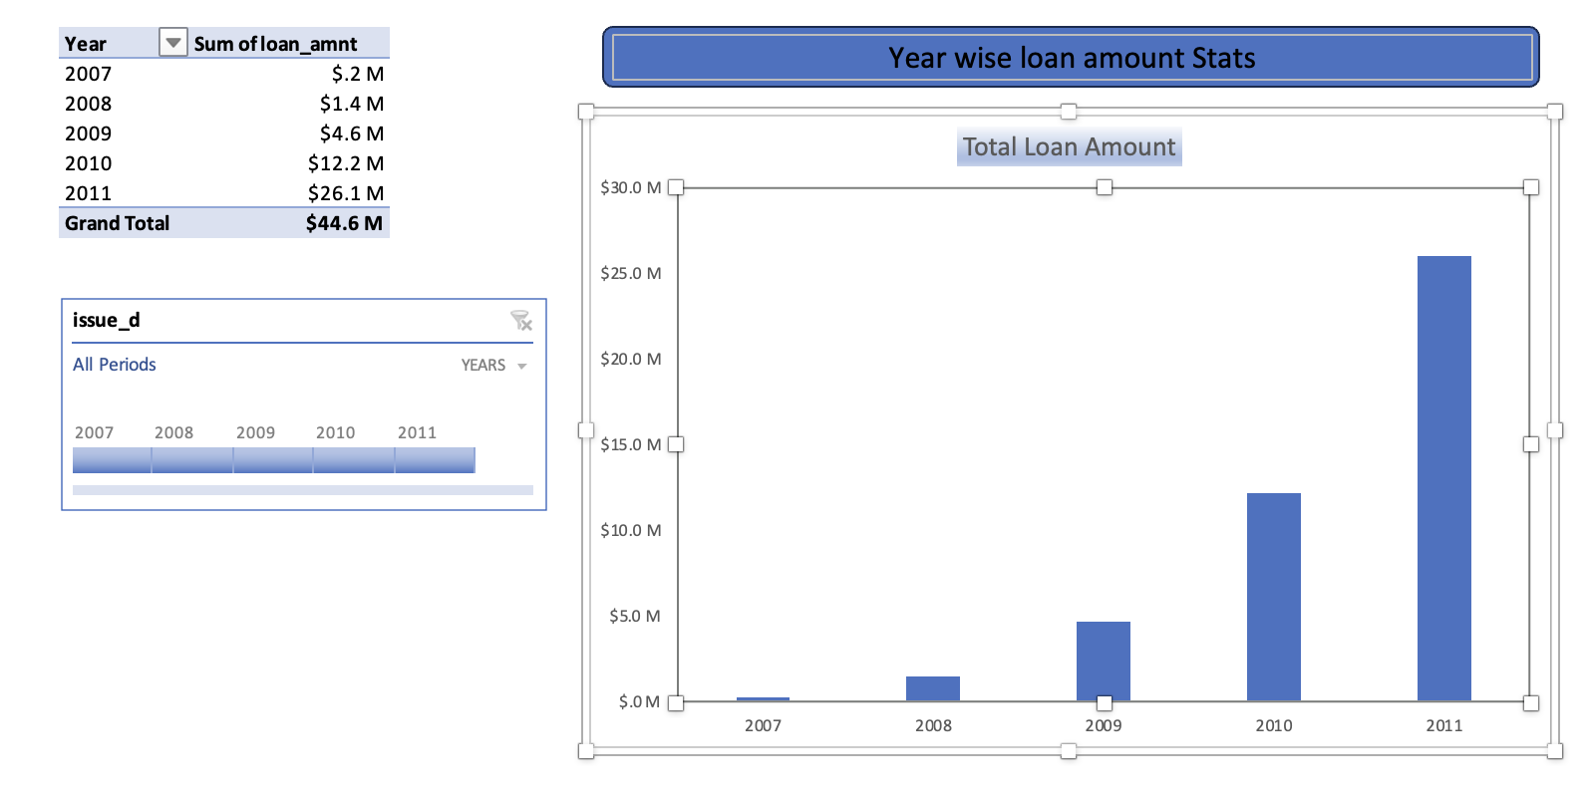
KPI-1 : Year wise loan amount Stats
By examining the chart, we can observe a consistent increase in the loan amount over the years. For instance, from 2007 to 2011, the loan amount surged from 22,19,275 to 26,05,06,575.
Calculating the difference between these two amounts shows an increase of 258,287,300 over a span of 4 years. The grand total of all years amounts to 44,56,02,650.00.
This indicates a substantial growth in the loan portfolio over the analyzed period.

Slide 5
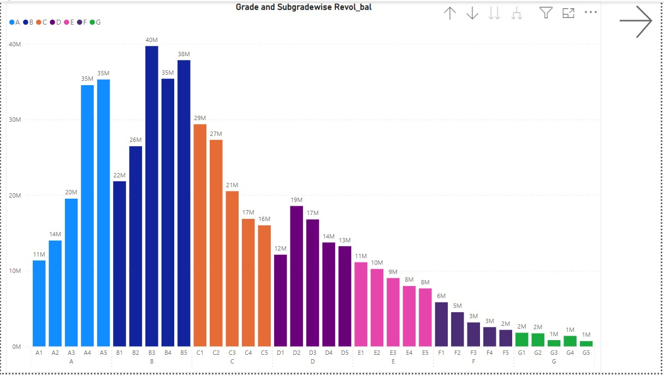
KPI-2 : Grade and sub grade wise revol_bal
In the loan grading system, each loan is assigned a quality score based on various factors such as the borrower's credit history, collateral quality, and the probability of timely repayment of the principal and interest. Upon analysis, it was discovered that Grade B loans exhibit the highest revolving balance, whereas Grade G loans have the lowest revolving balance.
Further investigation revealed that among Grade B loans, the top 5 countries with the highest revolving balance are California, Florida, New Jersey, New York, and Texas.
Moreover, in the year 2007, Grade C sub-grade C3 had the highest revolving balance, while in the year 2011, Grade B sub-grade B3 exhibited the highest revolving balance. These insights highlight the variations in revolving balances across different loan grades and sub-grades over the years.

Slide 6
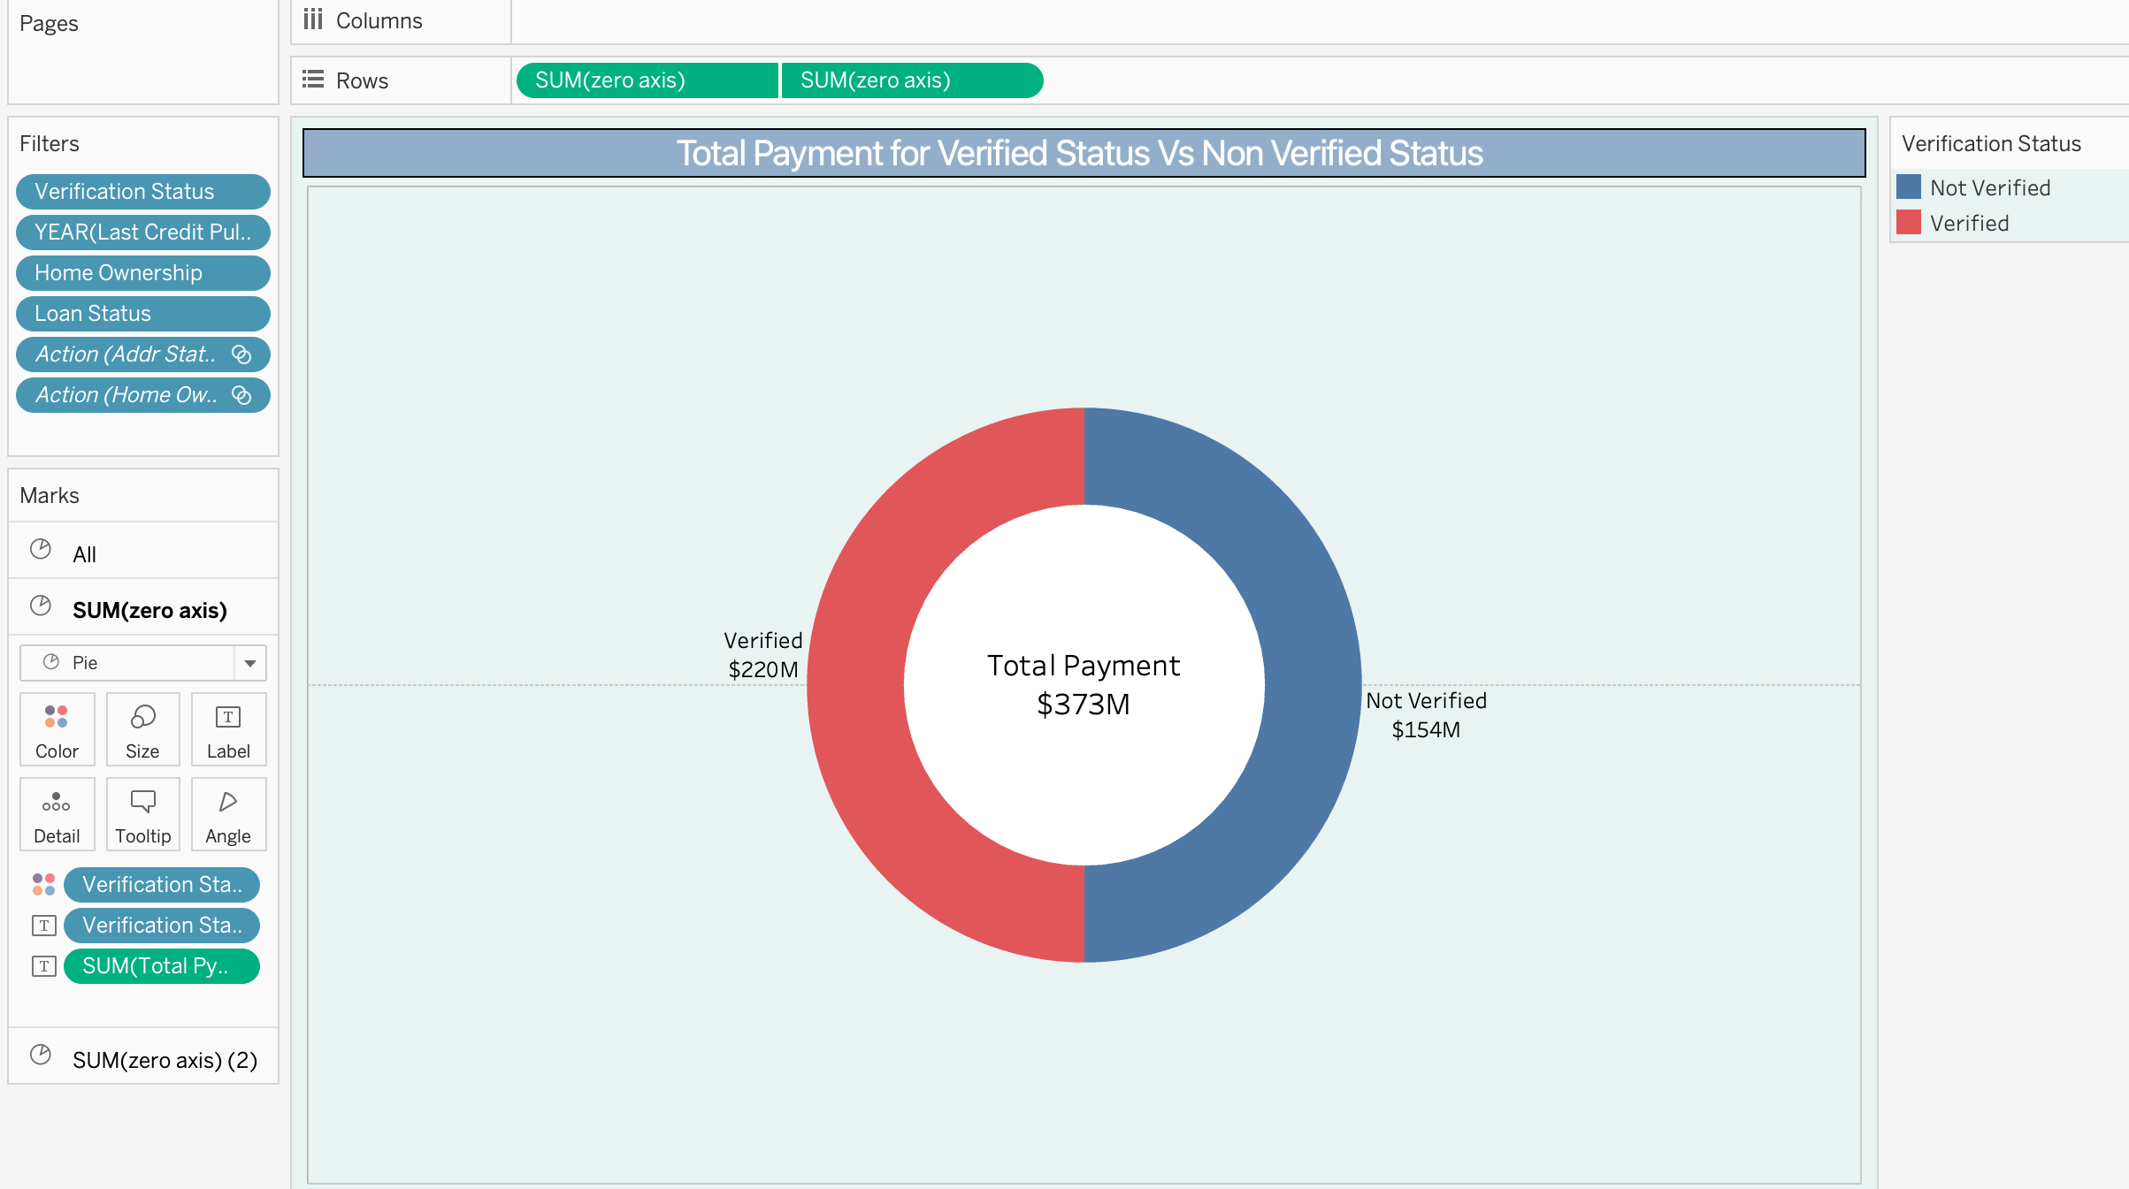
KPI-3 : Total Payment for Verified Status Vs Total Payment for Non Verified Status
The pie chart illustrates that 58.88% of the total payments are associated with verified loan applications, while 41.12% correspond to non-verified applications.
This indicates that verified applications constitute a larger portion of the total payment compared to non-verified applications in the initial stage of the verification process.

Slide 7
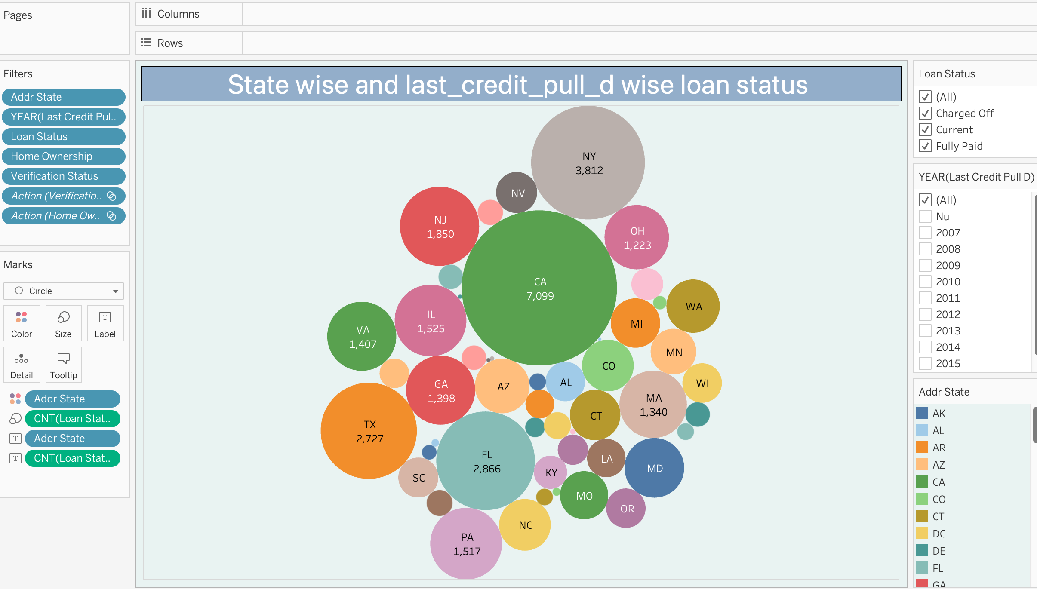
KPI-4 : State wise and last_credit_pull_d wise loan status
The bubble chart demonstrates the count of loan statuses in each state of the USA on the last credit pull date. Notably, California (CA) exhibits the highest number of customers who have taken loans, with a count exceeding 5000.
Moreover, it's evident that approximately 97% of bank customers across all states have a status of fully paid. This underscores a high rate of successful loan repayments among the bank's clients.

Slide 8
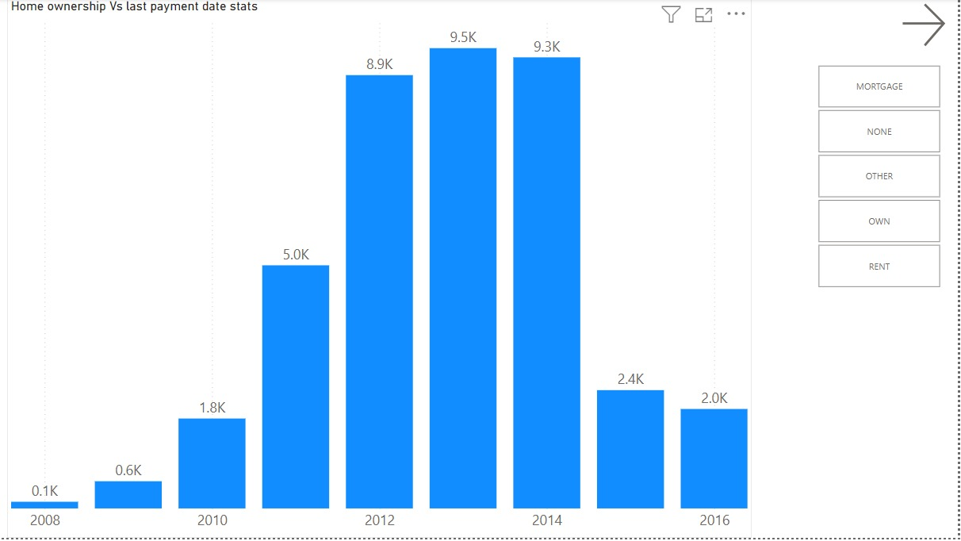
KPI-5 : Home ownership Vs last payment date stats
Between 2008 and 2014, there was a gradual increase in the count of home ownership loans. However, from 2014 to 2016, this count began to decline.
Upon closer examination, it was found that California had the highest count of rent home ownership loans among all states.
Additionally, the analysis indicated that both rent and mortgage loans were widely accepted within the home ownership loan category, suggesting a diverse range of financing options being utilized by borrowers in this sector.

Slide 9
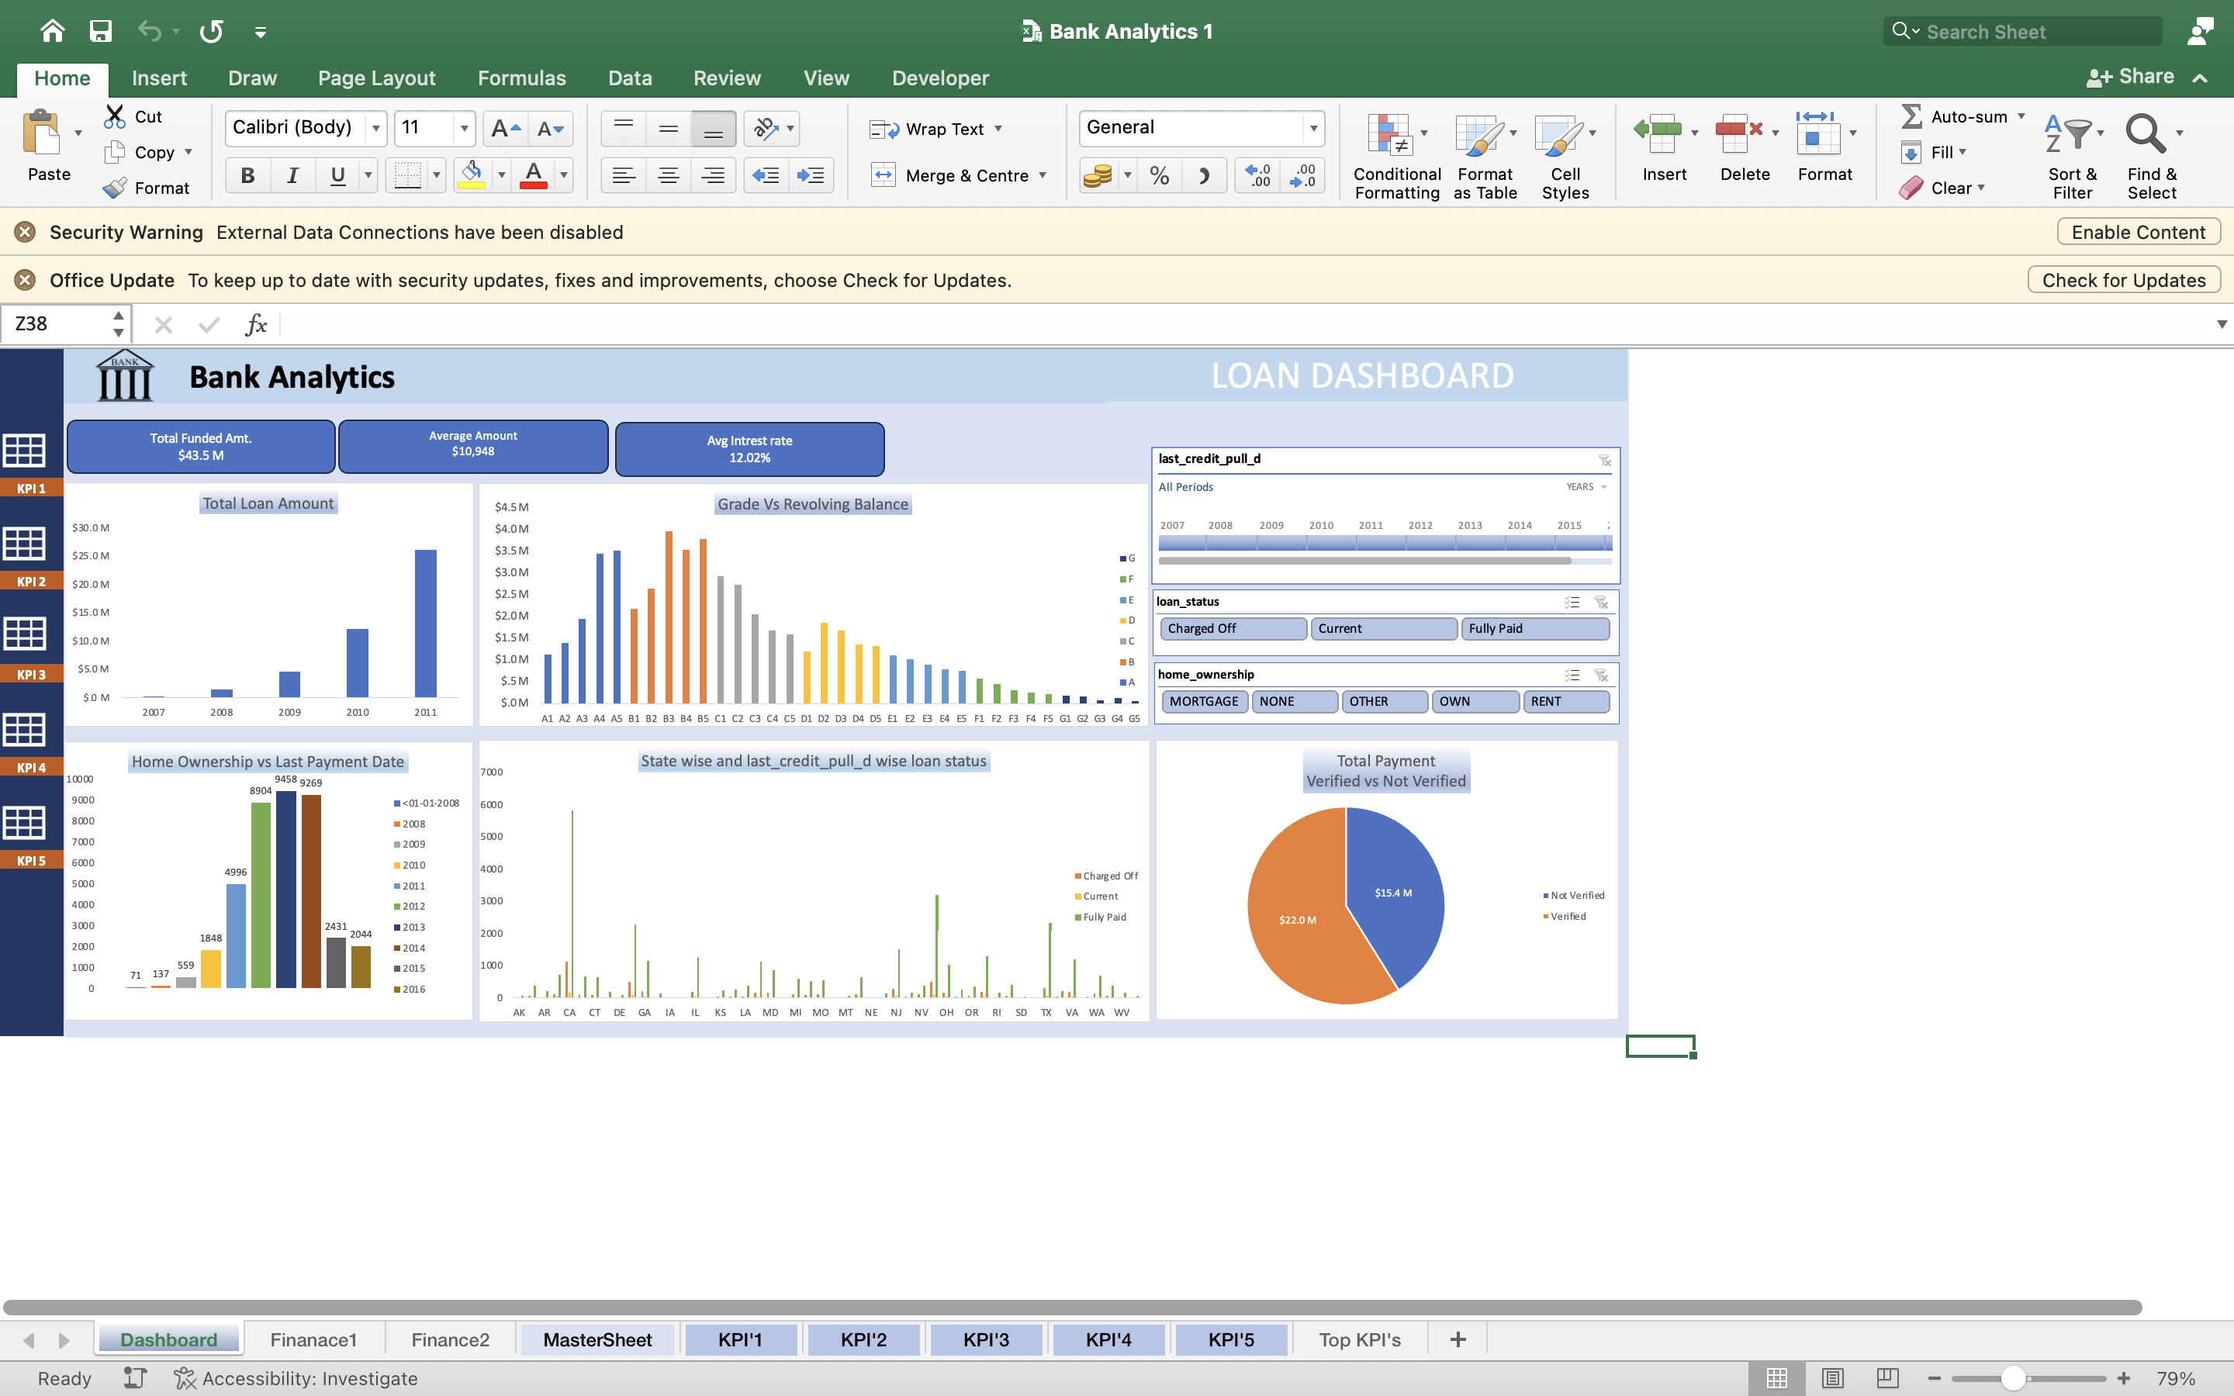
Excel Dashboard

Slide 10
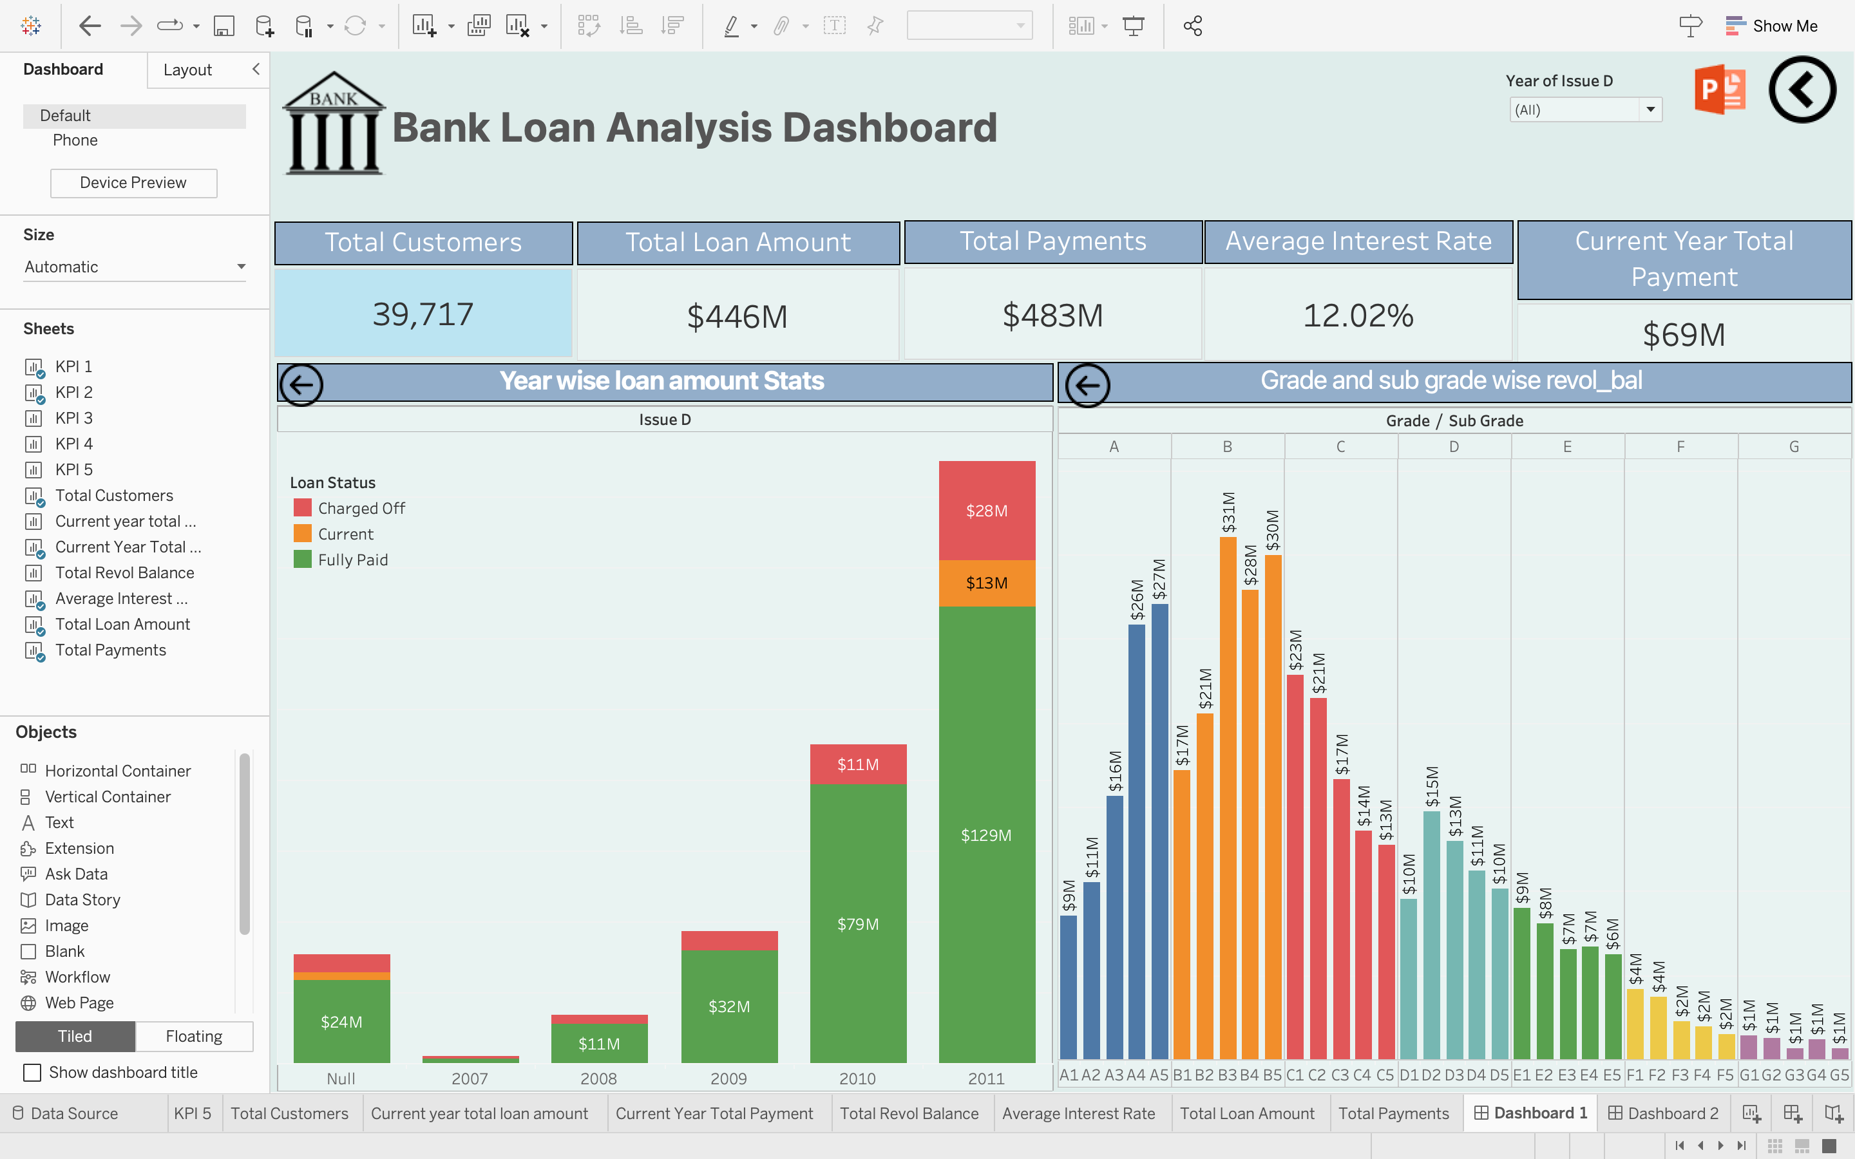
Tableau Dashboard

Slide 11
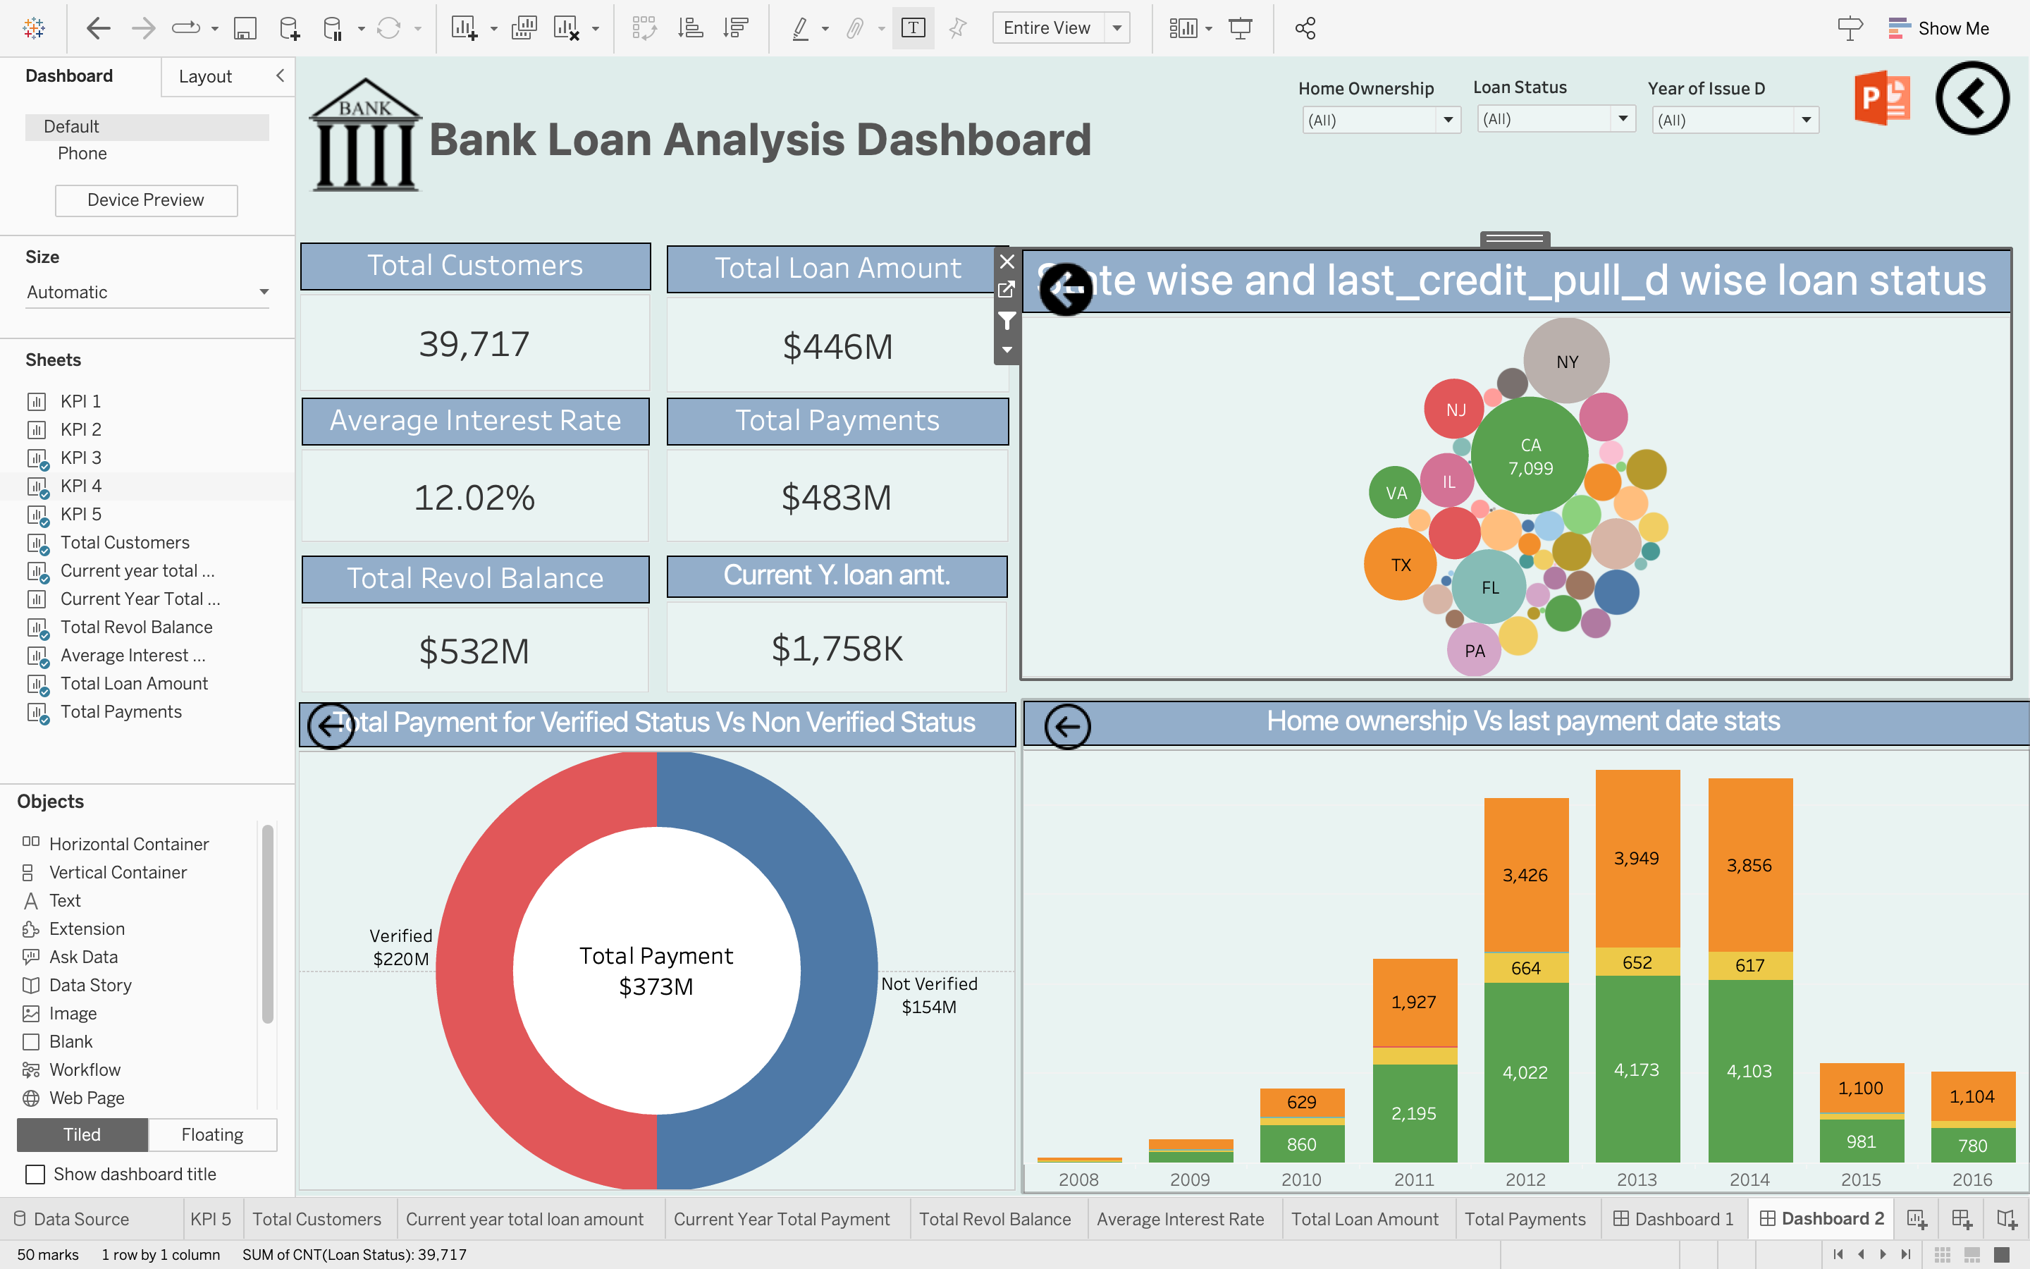
Tableau Dashboard

Slide 12
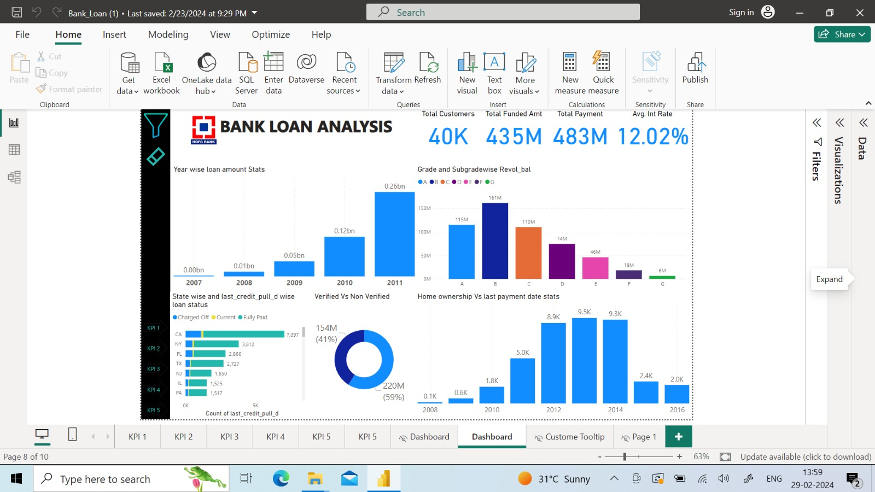
Power BI Dashboard

Slide 13
Thank you

